Slide 1

An IoT-alert System for Chronic Asthma Patients
Lebombo bone group
Gabriel Nishimwe
Kaiza Kunonu Ilomo
John Waithaka

Slide 2
“Research proposing a technology should assess not only its functional performance but also its usability”
The presentation shows:
Intro and Methods
Results
Limitations and Discussions
To demonstrate an example of how neglecting the user can lead to the development of functional but unusable technology.

Slide 3
Introduction
Agrippina Mwangi, MSC in ECE at CMU Africa 2021, 6 publications.
Bonaventure Karikumutima, MSC in IT CMU Africa 2014, 1 publication
Emmanuel Ndashimye, Doctor of Philosophy (Ph.D.) in Wireless Networking (V2I Communication) at AUT (Auckland University of Technology) in New Zealand in 2017, 11 publications
Sayan Kumar Ray, Doctor of Philosophy (Ph.D.) in Computer Science and Software Engineering at the University of Canterbury in 2012, 91 publications.
The paper discusses about IoT-based system intended to assist asthma patients in Rwanda, ensuring they receive prompt support when needed

Slide 4
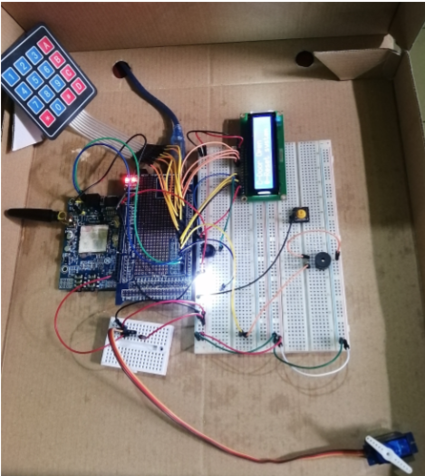
Introduction: System Prototype

Slide 5
Methods
Sampling Technique: Convenience sampling.
01
Data Collection Period: 10 weeks in short rainy season.
02
Testing Environment: University hostel.
03
Volunteer Training: 15 Student volunteers.
04

Slide 6
Results
Ambulance services - 25 minutes
Significantly faster response to emergency alerts - 1 to 6.5 minutes
Sound buzzer was the most efficient alert mechanism
2.5% of false positive triggers
Source: An IoT-alert System for Chronic Asthma Patients

Slide 7
Limitations
Alert device is wall-mounted
Manually triggered
Complex interface for the intended user
SMS used for alerts. I don’t read my SMS
Relies on the national grid for electricity
The proposed system is hardly usable.

Slide 8
Discussion
Impressive results yet highly unusable solution?
The assessment of the “goodness” of a technological solution must factor in its intended users
“Technology should be judged by its impact on people and society, not just by its technical capabilities – ChatGPT

Slide 9
Conclusion
Researchers deployed and assessed the performance of an IoT alert system for asthma patients in Rwanda with a sample of student volunteers to test the system.
Despite the system providing support and sending alerts and notifications to neighbors, a percentage of false positive triggers were found.
The research proposes a functional but unusable system because it does not factor in its users in the system’s analysis.

